Slide 1

Team 3 – Hackathon Case Study
Looking into the Future
Retail Sales Forecasting using ARIMA
Architecture
IT Services
Business Solutions
Consulting

Slide 2
Use Case Understanding & Implementation
Application
Create Model
Upload
Provision Warehouse
Sales History Data
Predict
Inventory Team
Actual
Sales Department
Sales History Data
Analyst Team
Save p,d,q
ABC Corp sells electronic products via it’s 3 channels – “Direct Store Order”, “Direct Online Sales” and “Phone Order” . It’s sales department generates a CSV file of weekly sales of their product every week. For every week they also calculate a set of attributes like “Net Unit”, “Last Year”, “Year Over Year”, “Week Over Year” etc of their actual sales. This generated csv file is handed over to the analyst team.
The analyst team first analyses the data to fit in a ARIMA model(finds out the value of p,d,q) and then feeds the CSV file to a web application “Forecast App” via it’s Admin interface. The web application runs ARIMA model on each product based on the sales history attributes and forecasts the expected sales for a FUTURE year.
Warehouse department can log into the same web application and view the predicted sales for the future year based on the selection of Historical data. They can also see a graphical representation of the projected sales to enable them have enough inventory.

Slide 3
Assumptions
The sales department would share their historic sales data in a predefined CSV format.
One product is only available to one mode of sale (channels).
The sales department will furnish the historical sales figures of past two years (2018 & 2019) for each product under a channel with their with applicable attributes (“Net Unit”, “Last Year”, “Year Over Year”, “Week Over Year” etc). All historical data figures are pre calculated and available for analysis. The application is not responsible for calculating these values and are displayed as available.
Actual History data is available for the past two years on a weekly basis (104 weeks) for each product under each channel. The “Net Unit” figures has been assumed to show a linear trend of 1 unit increase week over week.
The application can ONLY predict for a defined no of periods (52 weeks) for the next available year (2020).
ARIMA based future forecasts are ONLY based on attribute “Net Unit” for each product sold per week. Predictions for the other attributes are not applicable and hence shown as “-”
Predictions would be run on the entire history dataset as soon as the new data for a week is available. This would void out existing predictions to be replaced with NEW predictions based on the ARIMA model on “Net Unit”. Hence old predictions become invalid as new set of history data is available and hence removed.
The sales of each week are marked to date of the start of that week. Ex quantity sold for the week of 8th Jan 2018 to 14th Jan 2018 are stored with date of 8th Jan 2018. Similarly predictions for 3rd Feb 2020 to 9th Feb 2020 are stored with date of 3rd Feb 2020.
The ARIMA model to be used (defining of the p, d, q parameters) is done by the analyst team based on available ML algorithms. The arrived values of p, d and q values of the model defined are shared/stored in the DB. Prediction analysis for the future year would be using these set values during a new history file upload.
The ARIMA Order has been assumed to be the same across all Channel and product combinations.
The users of the application have access to Chrome as their only approved browser.
The development team has access to a public cloud env (Amazon Web Services)

Slide 4
System Architecture
Script
spawn
NoSQL Datastore
Controller
Model
Mongodb driver
Server side
Router
Rest APIs
http
Model
Services
Components
Client side
View
(Angular Material + HTML5 + CSS 3)
Notebook
Sales History Data
Angular 8

Slide 5






Deployment Architecture
Legend
User Data Access
Deployment
Users
Internet
AWS Cloud
Parallel fork
Angular Component Job
Branch
Run Tests
Build
Deploy
3
Node Component Job
Deploy
Angular Component S3 Bucket
(Hosted as a Static Website)
Node Component S3 Bucket
(Private S3 repository bucket)
2
Run Tests
Build
Deploy
SCM
Trigger
Build & Deployment Pipeline
1
5
Commit
4
Pull
Trigger
AWS Code Deploy
VPC
Visual Studio Code
6
Install
Private subnet
EC2 instance
PROD Environment
Node Server
Mongo DB
Team

Slide 6
Key Application Features
Authentication and Authorization – Only registered users, RBAC, Passwords are encrypted in DB.
Documentation – Applicable for all layers including detailed component level for front end services along with Github README files with installation steps
Test cases – All testcases are run and builds succeed only upon ALL test case success.
Commented and Linted Code for all layers ensuring code convention standards.
Centralized Source Code Management - GitHub used for version control and collaboration.
Use of open source tools, environments, packages and libraries for key functionalities
Db driven dynamic data lookups
User Notifications for all actions
Input Validation for all forms
Build using Business 4.0 principles

Slide 7
Open source packages used
Layer | Feature | Package(s) Used
Frontend | Application styling | angular/material and angular/flex-layout
Frontend | Graph data presentation | canvasjs
Frontend | Notification | ngx-toastr
Frontend | Documentation | compodoc
Services | Authentication and Authorization | passport and passport local
Services | Session Management | jsonwebtoken, express-session
Services | Cross-origin Resource Sharing(CORS) | cors
Services | Password encryption | bcryptjs
Services | File upload and parsing | multer and csvtojson
Services | Logging | morgan
Services | Data analysis in Python | Pandas, numpy
Services | Prediction | statsmodels
Frontend & Services | Static code analysis | lint and jshint
Frontend & Services | Unit Test Cases | Jasmine, Karma, Mocha and Supertest

Slide 8
Open source packages used continued
Layer | Feature | Package(s) Used
Services | Dynamic load of environment variables | dotenv
Services | Daemon process manager | PM2

Slide 9
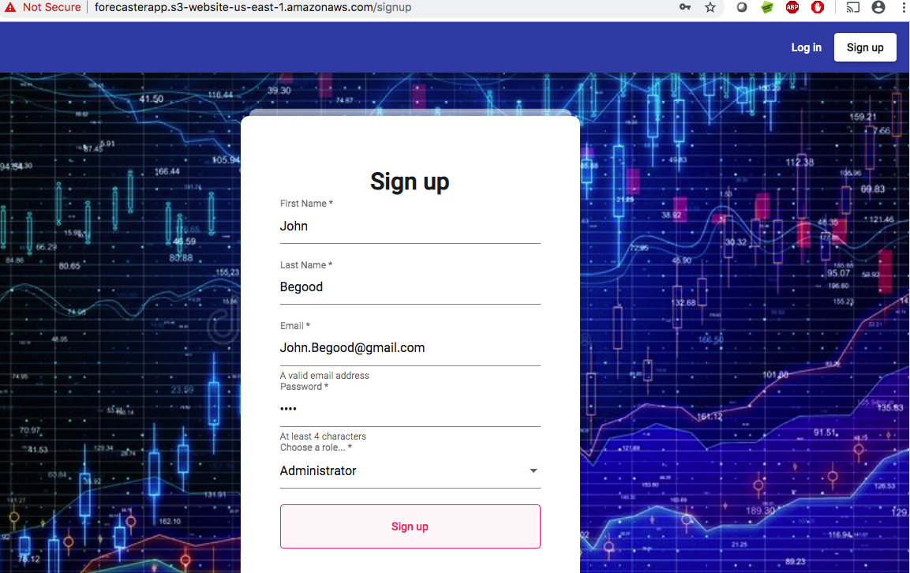
Screen Layout for Sign up for new user
PROD URL: http://forecasterapp.s3-website-us-east-1.amazonaws.com/
Pre-login menu header
Required Field Validation
Pattern based Validation
DB data driven dropdowns

Slide 10
New User Sign up – Sequence Diagram
User
Angular UI
Nodejs
Services
Mongo
DB
GET Sign up route
Show Sign up
page
SHOW Sign up page
Provide details
VALIDATE
Validate user data
save()
SUCCESS status
SUCCESS status
SUCCESS message
SHOW Sign in page

Slide 11
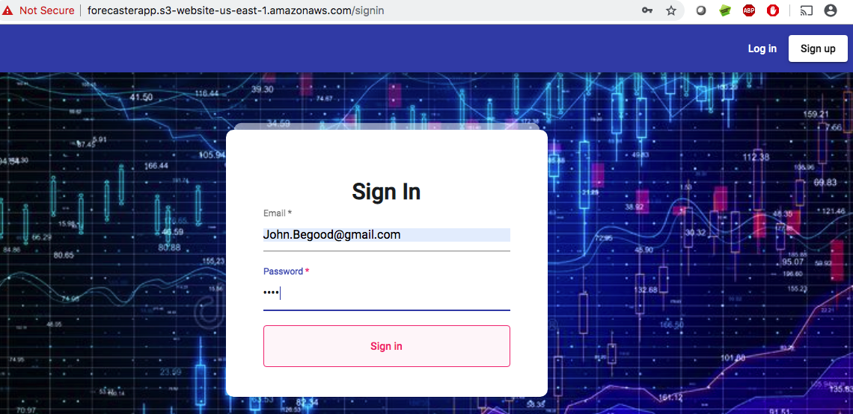
Screen Layout for Sign in for existing user
Consistent Material Layout
Authentication, Authorization initiating session, jwt token generation

Slide 12
Existing user Sign in flow
User
Angular UI
Nodejs
Services
Mongo
DB
GET Index route
Show Sign in
page
SHOW Sign in page
Provide credentials
VALIDATE
GET user data
findOne()
USER data
Authenticate via Passport middleware
SUCCESS status with JWT
Generate JWT
Dashboard page

Slide 13
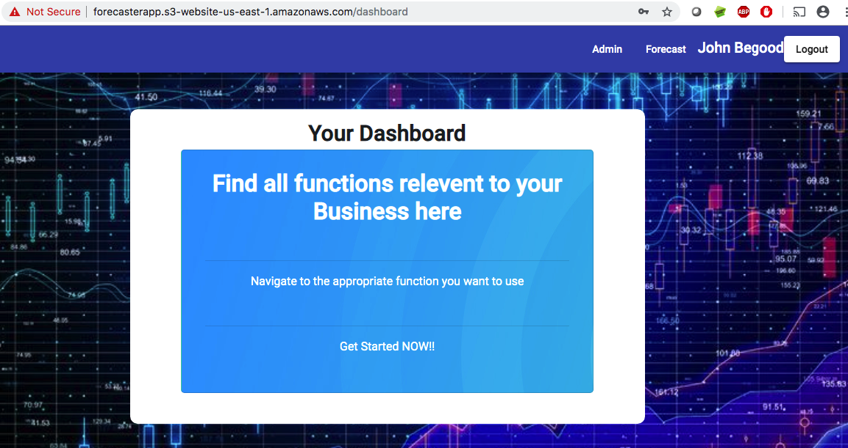
Dashboard/Landing page post signup
User Customization
Post login menu
AuthGuard protected routes
Role Based Access Control

Slide 14
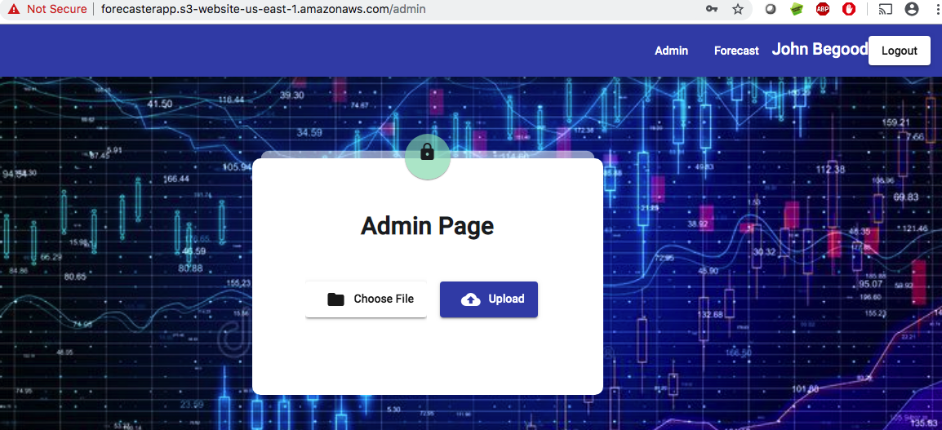
Screen layout for Admin Page (Analyst team only)
Upload Control

Slide 15
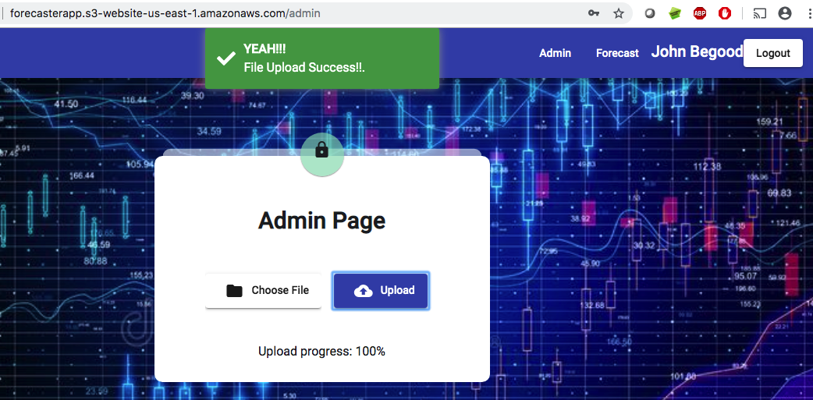
Admin File Upload Success
AuthGuard protected routes
Consistent User Notification
Progress Tracker

Slide 16
Admin Page - Sequence Diagram – Save History and Calculate Forecast Data
User
Angular UI
Nodejs
Services
Python
Mongo
DB
GET upload page
Show upload
page
SHOW upload section
upload data csv file
VALIDATE csv file
PUT data
DELETE existing data
SAVE new data
(History)
SUCCESS message
Call predict
Forecast data
SAVE new data
(Forecast)
SUCCESS message
SUCCESS message
SUCCESS message

Slide 17
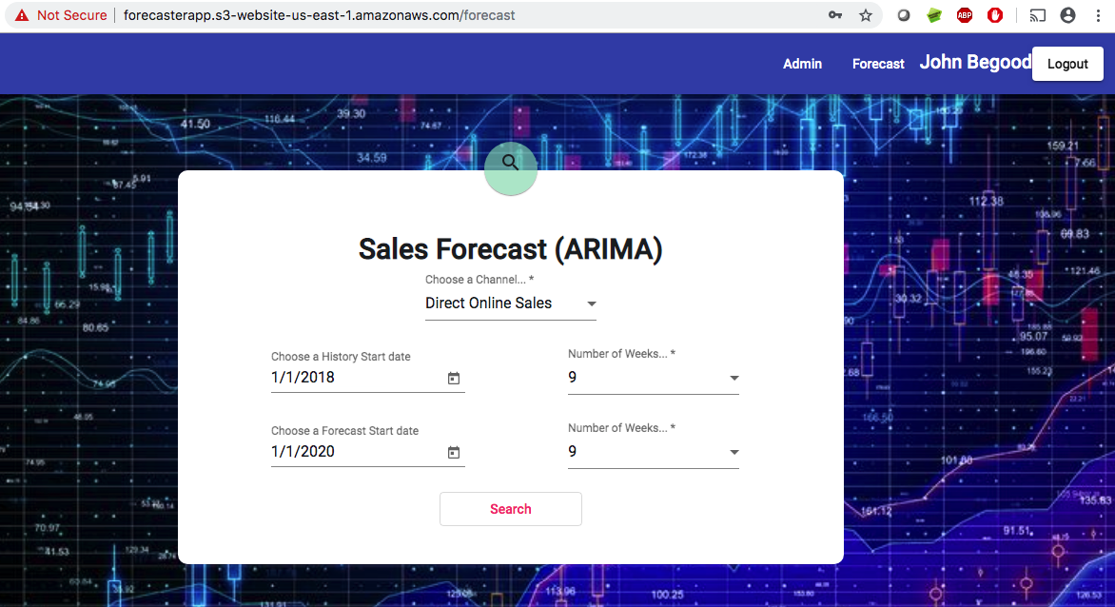
Screen layout for Forecast Page – Search Section
Date Widget
Required field validation
DB data driven dropdowns
Validation triggered buttons

Slide 18
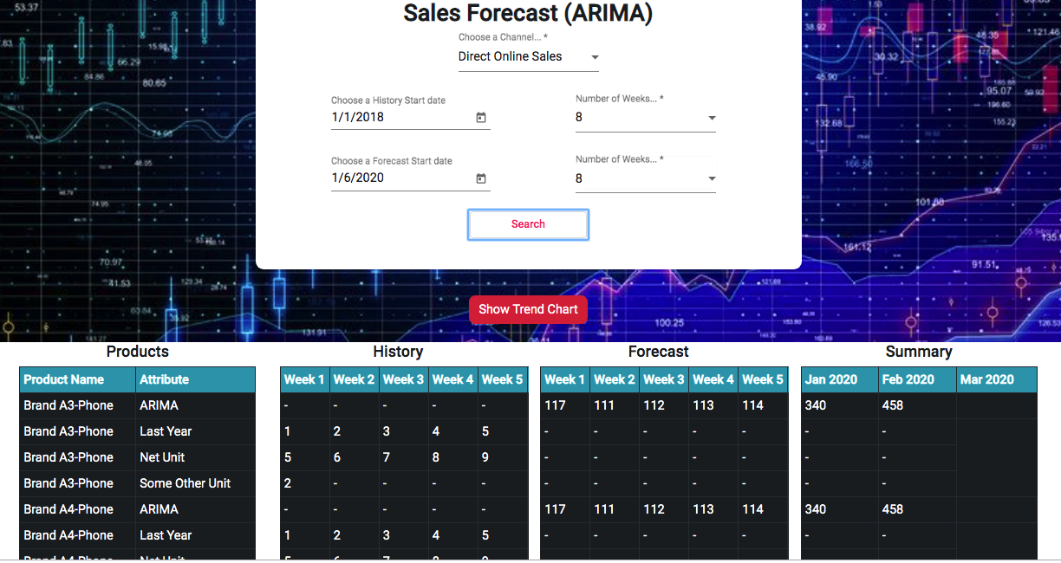
Screen layout for Forecast Page – With Results
Dynamic product based attributes
Ordered products/attributes
0 values
replaced by “-”
Scrollable subsections

Slide 19
Forecast Page - Sequence Diagram – Fetch Query and Data Section
User
Angular UI
Nodejs
Services
Mongo
DB
GET home page
GET master data
GET master data
QUERY for master data
POPULATE calender & dropdowns
SHOW home page
SELECT Query section
QUERY criteria
QUERY criteria
QUERY for history & forecast data
RESULT data
PUT in table
POPULATE data in table
SHOW table section

Slide 20
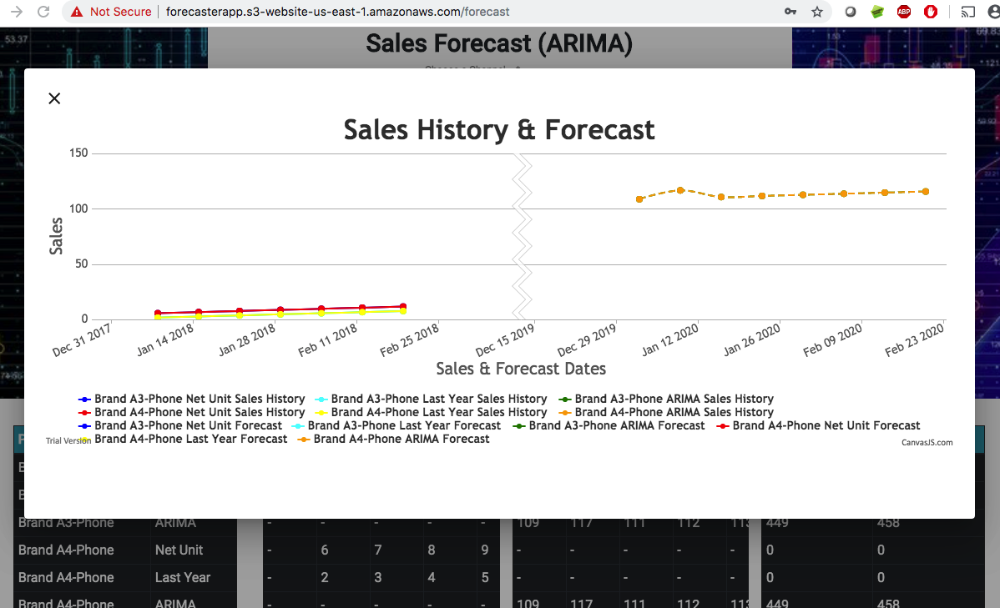
Screen layout for Forecast Graph (opens as a modal popup)
Section Divider between History & Forecast
Quantity value display on hover
Sale Dates
Color Legends

Slide 21
Graph popup - Sequence Diagram – (Fetch Graph data)
User
Angular UI
Nodejs
Services
Mongo
DB
SELECT Query section
QUERY criteria
QUERY criteria
QUERY for history & forecast data
RESULT data
PUT in graph
POPULATE data in graph
SHOW table section

Slide 22
DB Design - NoSQL
channels
channelId: String
channelName: String
lookups
key: String
values: Object
 | key: String | value: String
modelparams
formDate: Date
toDate: Date
model: Object
 | Key:String | Value: Number
MASTER Collections
users
firstName: String
lastName: String
email: String
password: String
saltSecret: String
salesHistories
channel: String
saleDate: Date
product: String
attribute: String
quantity: Int32
salesForecasts
channel: String
saleDate: Date
product: String
attribute: String
quantity: Int32
Transactional Collections
*Note: All collections have _id (Object) as their primary key which contains a unique ObjectID value

Slide 23
Scopes of Improvements
Following are the areas that can be enhanced upon over the current application:
Make UI cross browser compatible
Make the UI responsive
Enhanced look & feel
Fix the issue of Null column in Summary portion for weeks that overlap months
The calendar dropdowns needs to be only enabled for the dates history and predictions are available.
Use serverless architecture/containers for AWS environment
Enhance python script to be able to predict on all available attributes
End to end SSL encryption for all endpoints

Slide 24
Addendum: Business 4.0
Production version of the application is deployed on AWS Public Cloud and is accessible over public internet.
ARIMA based machine learning predictions using python, pandas and statsmodel packages.
CLOUD
INTELLIGENT
APPLICATION
AGILE
AUTOMATED
Continuous Code Integration and Code deployment pipeline through Travis CI and AWS Code Deploy.
Daily scrum calls to collaborate tasks even though the team was distributed across different locations and timezones

Slide 25
Thank You

